Slide 1

MediClip
Francois Janse van Vuren, Karl Foley, Jacobus Janse van Vuren

Slide 2
What is MediClip?
MediClip is essentially a virtual clipboard
MediClip will assist nurses when performing their daily tasks by simplifying patient paperwork
MediClip will be available on both Android and iOS

Slide 3
Main Features
Access patient information without the hassle of having to find the correct documents or searching through file cabinets
View a patients current dosage information
Perform a routine check on the patients condition
Add notes on a patient, including photos

Slide 4
Mobile Features
Utilise the phones camera functionality to allow users to add photos to their notes
Shake to clear functionality. Allowing users to clear text fields by shaking the phone (Only for text fields they are currently editing)
Notifications on when a patients medication is due

Slide 5
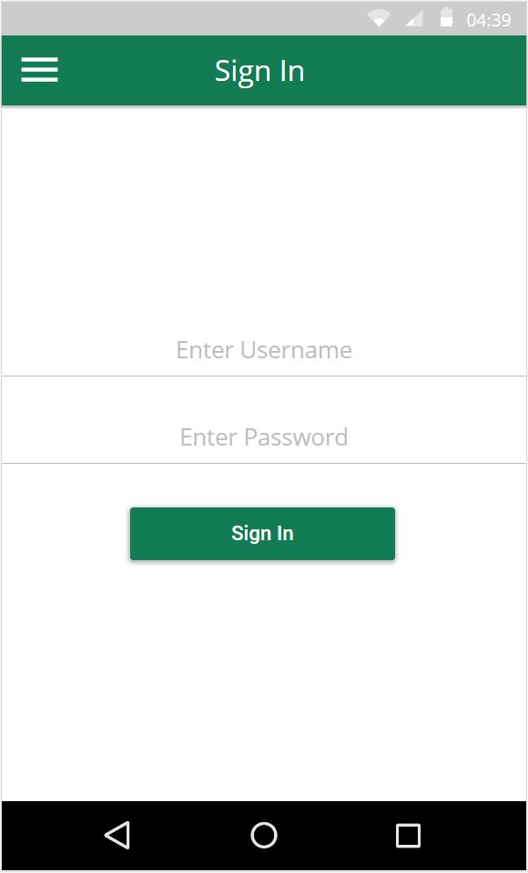
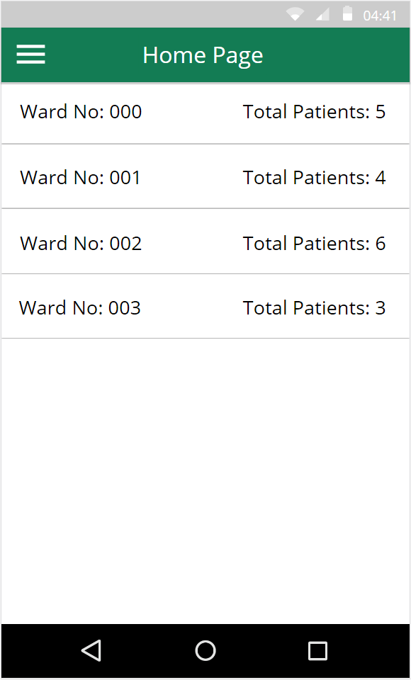
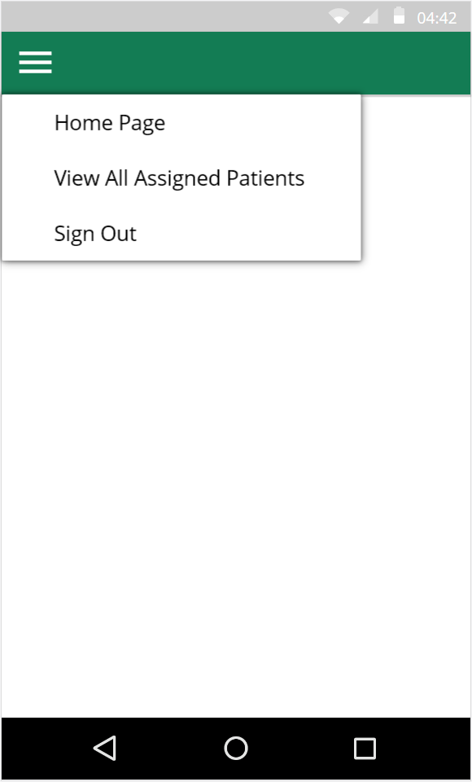
User Interface
Menu available from all screens
Back button provided
by Android OS
Tap to view patients
In ward
Notes:
* General Navigation
For general navigation the application will have a persistent toolbar. This toolbar will contain a page title and a hamburger menu. This menu provides shortcuts for easy navigation to the home page, view assigned patients and also an option to sign out of the app. The Android OS also provides a back button. We will also add a back button to the iOS versions toolbar since one is not provided natively.
* Sign in
The first thing the user is presented with is a sign in page. Once the user signs in the home page is displayed.
* Home Page
From the home page the user will see all their assigned wards. The total amount of patients in the ward is also displayed. From here the user can tap on one of the wards to view the patients assigned to that specific ward.

Slide 6
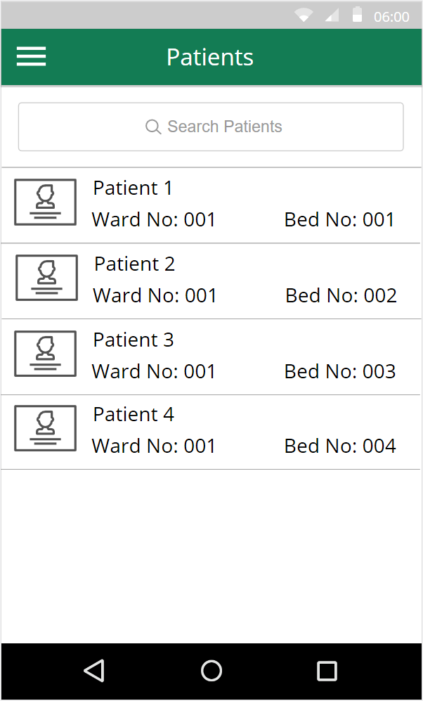
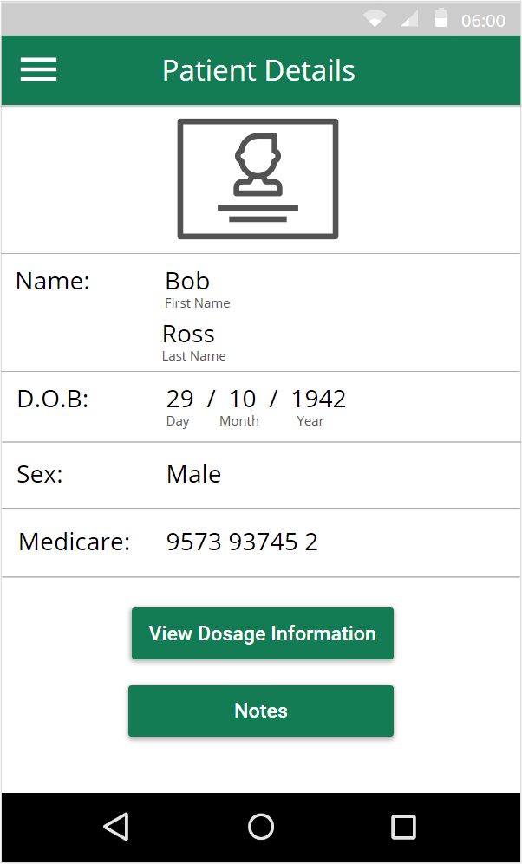
User Interface
Displayed as message
box
Tap to view patient details
Notes:
* Patients
On the patients page the user will see a list of all their assigned patients. When the user taps on one of the patients, the patient details page is displayed. On this page the user can view the patients dosage information and notes.

Slide 7
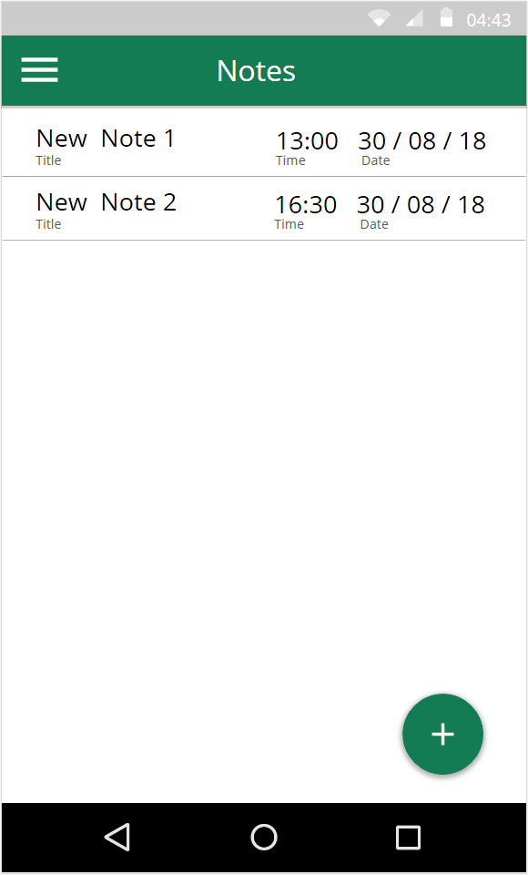
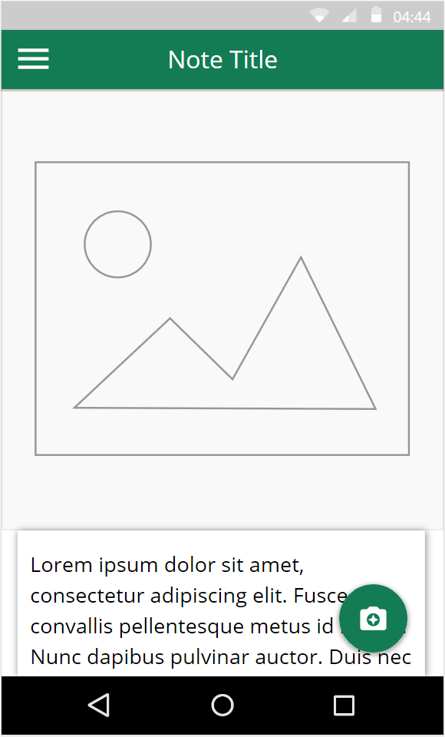
User Interface
Tap to view/edit note
Scroll down to
see text
Add photo to
note
Shake to clear text
Tap on text box to edit
Add new note
Notes:
* Notes
When the notes button is pressed, a list of all the patient notes are displayed. The user can tap to view or edit the note or create a new one by tapping the plus sign in the bottom right corner. When viewing a note the user can edit text and optionally add a photo. The photo will be displayed above the note text. The user also has the ability to scroll down to reveal more text. The text in the note can be cleared easily by shaking the phone.

Slide 8
Research
Data Storage —in a form of a SQL Server — Week 3
Search functionality — Using SQL inside a app
Network connectivity — Week 8 & week 9
Camera — Week 5
Accelerometer — Week 5
Notifications

Slide 9
Why? Case Study – John Hunter Hospital
Admissions
80,000 patience a year.
40,700 non-emergency patients
29,800 emergency patients
Current Systems
Computer based client patient management system
Drug management distribution system
Patient status reports done in paper
Patient status reports differ between wards.

